Slide 1
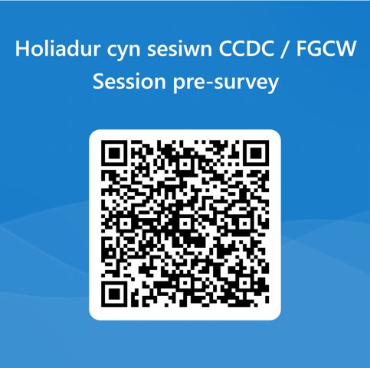
Gloywi ar Deddf Cenedlaethau'r Dyfodol (Cymru)​
Refresher on the Well-being of Future Generations (Wales) Act
https://forms.office.com/e/s8L6rZtzEB
cenedlaethaurdyfodol.cymru | futuregenerations.wales | @futuregencymru

Slide 2
Gloywi ar Deddf Llesiant
Cenedlaethau'r Dyfodol (Cymru)
Refresher on the Well-being of Future Generations (Wales) Act
@futuregencymru
cenedlaethaurdyfodol.cymru futuregenerations.wales
3rd August 2023
3ydd Awst 2023

Slide 3
Y sesiwn yma / This session:
Trwy'r sesiwn hon byddwch yn:
Cynyddu eich gwybodaeth am Ddeddf Llesiant Cenedlaethau’r Dyfodol a’r hyn y mae’n ei olygu i gyrff cyhoeddus.
Dyfnhau eich dealltwriaeth o sut mae egwyddor datblygu cynaliadwy yn siapio ac yn dylanwadu ar sut mae cyrff cyhoeddus yn gweithio.
Datblygu sgiliau gweithredu yn unol â'r egwyddor datblygu cynaliadwy (yn seiliedig ar y pum ffordd o weithio).
Defnyddio’r adnoddau ac offer a fwriedir i'ch helpu i dynnu'r dysgu oddi arno a'i gymhwyso i'ch gwaith eich hun.
Through this session you will:
Increase your knowledge on the Well-being of Future Generations Act and what it means for public bodies.
Deepen your understanding of how the sustainable development principle shapes and influences how public bodies work.
Develop skills in acting in accordance with the sustainable development principle (centred around the five ways of working).
Use resources and tools intended to help you take learning away and apply it to your own work.
Ar ddiwedd y sesiwn byddwch yn gallu:
Siarad am Ddeddf Llesiant Cenedlaethau’r Dyfodol a pham ei bod yn ddarn mor bwysig o ddeddfwriaeth.
Eglurwch rôl eich sefydliad o dan y ddeddfwriaeth.
Rhoi enghraifft o pryd a sut i ddefnyddio'r ffyrdd o weithio.
At the end of the session you’ll be able to:
Talk about the Well-being of Future Generations Act and why it is such an important piece of legislation.
Explain your organisations’ role under the legislation.
Give an example of when and how to use the ways of working.
cenedlaethaurdyfodol.cymru | futuregenerations.wales | @futuregencymru
Notes:
Learning outcomes of the session.
What I will say at this point is that the Act is more of a way of thinking than a anything else. It is the oil and not the machine.
So, there will be elements of this session that some of you will find quite technical, possibly quite dry! And there are elements that are quite inspirational and more about hearts and minds. Different things appeal to different people so I hope there is something here for you in this room and to take away to inspire, instruct or possibly just irritate your colleagues.

Slide 4
Today / Heddiw
Introductions
Cyflwyniadau
Some practice
Ambell ymarfer
Introduction to applying the Act in practice.
Cyflwyniad i gymhwyso'r Ddeddf yn ymarferol.
Time to reflect and discuss
Amser i fyfyrio a thrafod
cenedlaethaurdyfodol.cymru | futuregenerations.wales | @futuregencymru
Notes:
How we're going to do that / outline of the session.
Give forewarning that we’ll be asking participants to introduce themselves and outline quickly what their idea, a current project, work problem or even a personal life scenario that they’d like to apply the Well-being of Future Generations Act
Ask participants to intro themselves and their project.

Slide 5
Introductions
Cyflwyniadau
Yn llai 'na 30 eiliad...
Eich enw
Eich rol a sefydliad
Eich syniad, prosiect cyfredol, problem waith neu hyd yn oed senario bywyd personal yr hoffech gymwyso'r Deddf iddo
In less than 30 seconds...
Your name
Your role and organisation
Your idea, a current project, work problem or even a personal life scenario that you’d like to apply the Act to
cenedlaethaurdyfodol.cymru | futuregenerations.wales | @futuregencymru

Slide 6
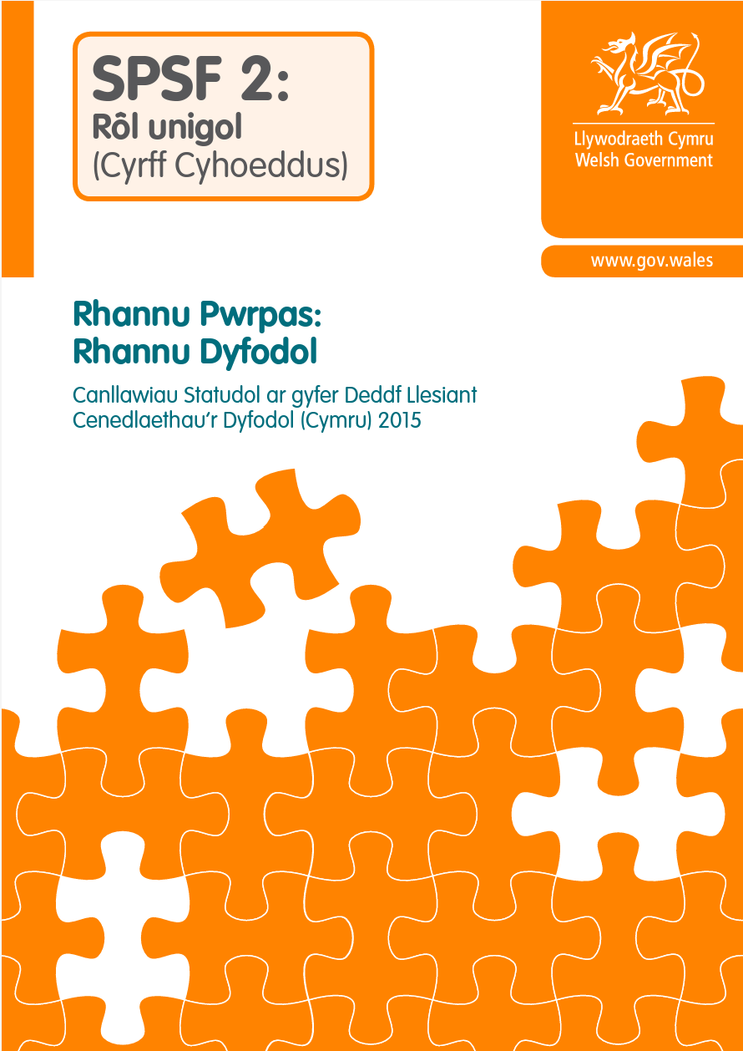
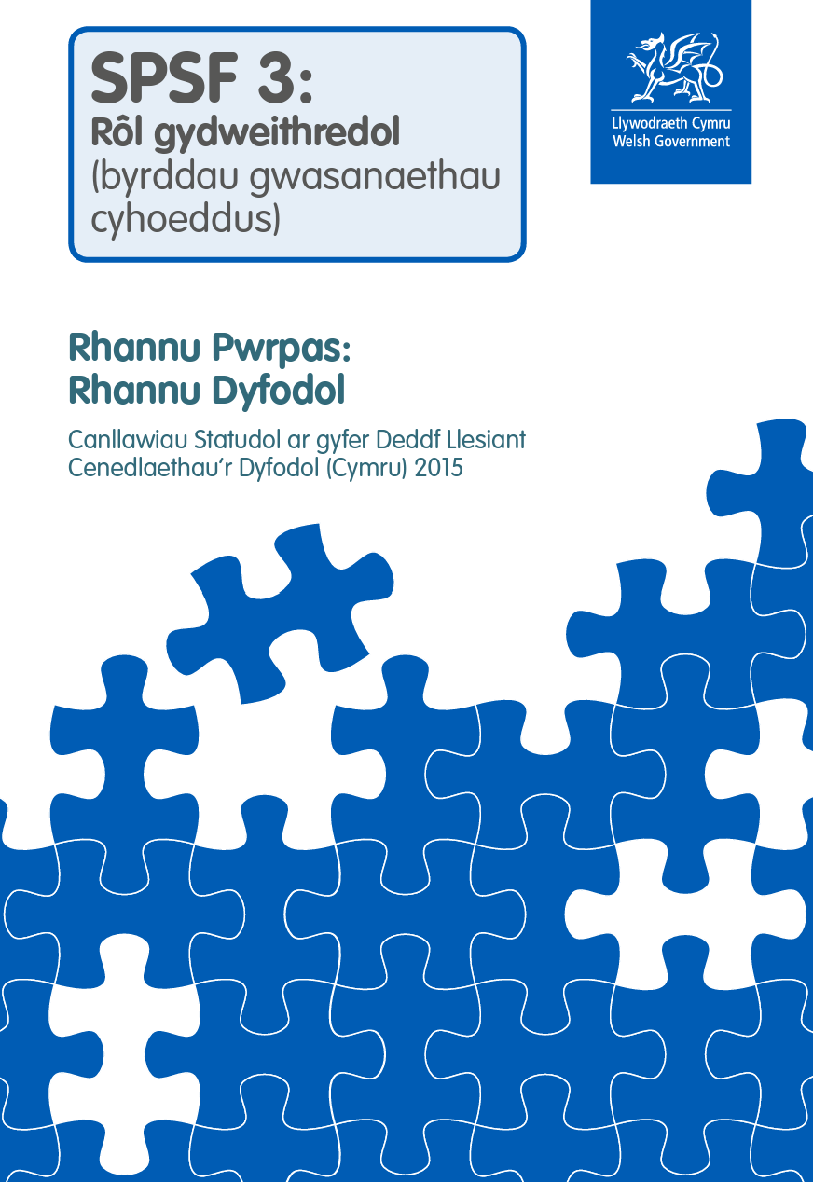
Amlinelliad o'r DdeddfOutline of the Act
cenedlaethaurdyfodol.cymru | futuregenerations.wales | @futuregencymru
Notes:
Hopefully people flicked through The Essentials, may have had time to read or watch some of the other things we sent over...
Also statutory guidance on the Act: https://www.gov.wales/well-being-future-generations-wales-act-2015-guidance

Slide 7
Egwyddor Datblygu Cynaliadwy / Sustainable Development Principle
"act in a manner which seeks to ensure that the needs of the present are met without compromising the ability of future generations to meet their own needs."
"i’r corff weithredu mewn modd sy’n ceisio sicrhau bod anghenion y presennol yn cael eu diwallu heb beryglu gallu cenedlaethau’r dyfodol i ddiwallu eu hanghenion hwythau."
Notes:
At the centre of the Act is the SD principle. This is defined in law – but sometimes, we like to refer to our organisations' strapline "Acting today for a better tomorrow" or, "Leaving the world better than we found it."
Although the concept of enshrining sustainable development (remember, acting today for future generations) in law is novel, it is not new as a way of thinking. Many indigenous people across the world including the Māori in New Zealand and the Haudenosaunee (ho-den-o-sion-eee) in what is now North America believe and practice the seven generations concept.
So, first step - we must carry out sustainable development, which means:
The process of improving environmental, social, economic and cultural well-being of Wales.
By taking action in accordance with the SD principle. But how does one do this?

Slide 8
cenedlaethaurdyfodol.cymru | futuregenerations.wales | @futuregencymru
Notes:
To apply that thinking - the sustainable development principle, the Act says we need to take account of these five ways of working and demonstrate we're doing so.
We're going to come back to these in much more detail – but for now, accept that they are your ingredients and your cooking method to cook up a storm for current and future generations.
Thankfully, unlike when you bake a cake in reality, it doesn't matter which one of these ways of working you apply first. They all lead to each other. And if we do this right, we can't go far wrong.
So that is how the Act says you can act today for a better tomorrow...but what about the first bit of improving the well-being of Wales?

Slide 9
National Well-being Goals
cenedlaethaurdyfodol.cymru | futuregenerations.wales | @futuregencymru
Notes:
Well, the Act gives us a common vision for all of us to work towards.
The Act takes the UN Sustainable Development Goals and translates them into a Welsh context, demonstrating what our small country can do to enact change.
And this was done in a way that involved thousands of people (the Wales we Want conversation etc.)
We can't just pick one or two of these goals either – we have to strive to contribute to all of them and maximise our contribution to them too. More about this later.

Slide 10
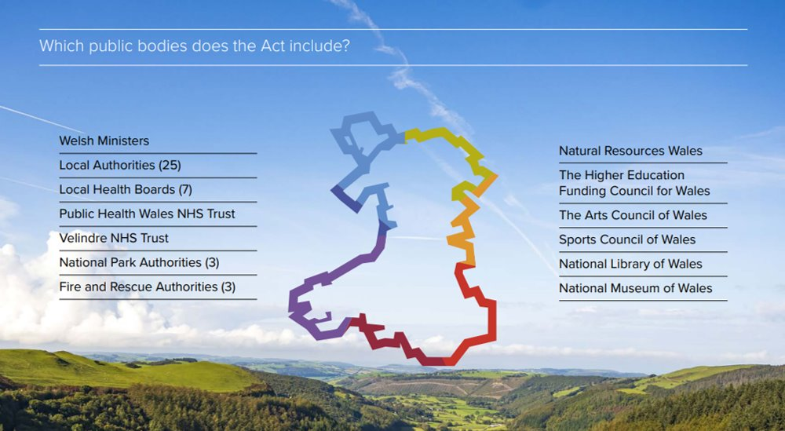
(22)
Additional bodies TBC:
Qualifications Wales
Social Care Wales
Health Education & Improvement Wales
Welsh Revenue Authority
Digital Health & Care Wales
Transport for Wales
Centre for Digital Public Services
Wales Ambulance Service Trust
Notes:
- Connection also to schools / colleges / Regional Skills Partnerships; Corporate Joint Committees and City Regions.
Individual duty to set well-being objectives that max. Contribution to well-being goals; publish well-being statement; report annually.
Up to them on when they review objectives (annual) and up to them on when they set new ones.

Slide 11
Byrddau Gwasanaethau Cyhoeddus
Public Services Boards
Assessiadau llesiant / Well-being assessments
Cynlluniau llesiant / Well-being plans
Cydweithio / Collaboration
Aelodau / Membership
Craffu / Scrutiny
Potensial / Potential
Notes:
Collective duty on PSBs. PSBs are required to
· assess the state of economic, social, environmental and cultural well-being in their areas (the Well-being Assessment)
· use that assessment to set local well-being objectives (the Well-being Plan)
· act together to meet those objectives.
Timings in line with Local Govt elections.

Slide 12
The Well-being for Future Generations Act Architecture

Slide 13
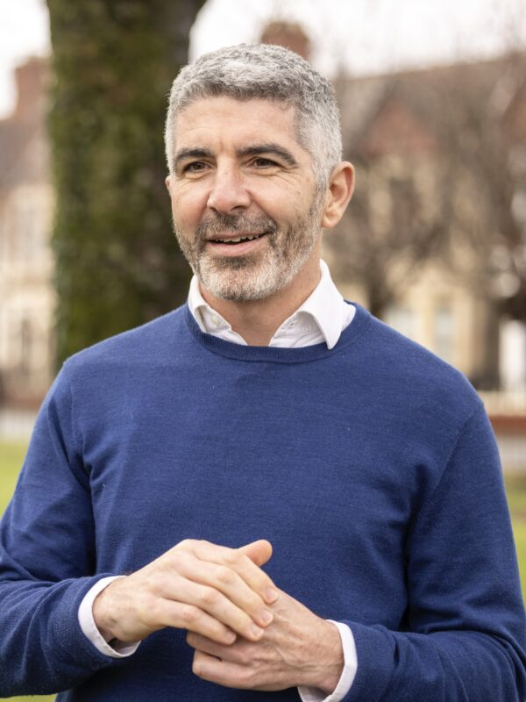
Comisiynydd Cenedlaethau’r Dyfodol Cymru
Future Generations Commissioner for Wales
'To act as a guardian of the ability of future generations to meet their needs'
Notes:
Accountability / Enabling the Change
First Future Generations Commissioner in the world with this sort of role etc.
In terms of how public bodies and PSBs interact with the Commissioner:
Section 18 Commissioner's general duty
The general duty of the Commissioner is—
(a) to promote the sustainable development principle, in particular to—
(i) act as a guardian of the ability of future generations to meet their needs, and
(ii) encourage public bodies to take greater account of the long-term impact of the things that they do, and
(b) for that purpose to monitor and assess the extent to which well-being objectives set by public bodies are being met.

Slide 14
Dyletswydd & pwer y Comisiynydd:

Slide 15
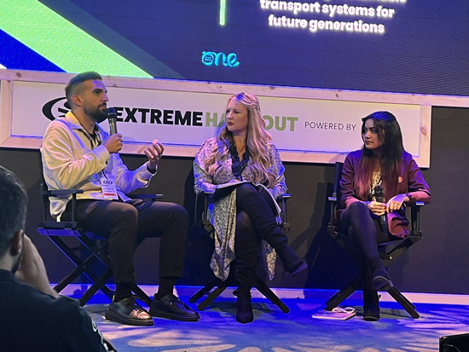
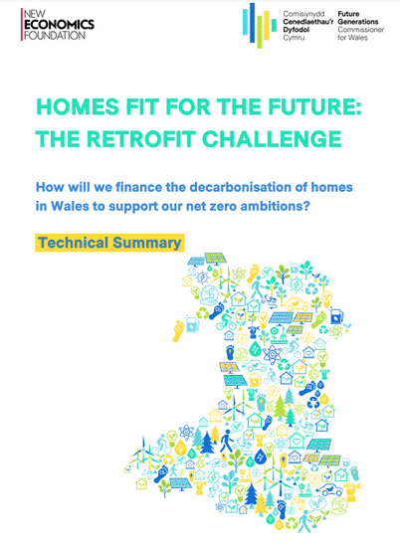
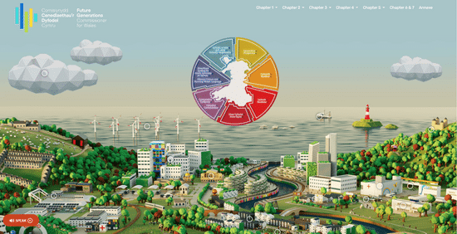
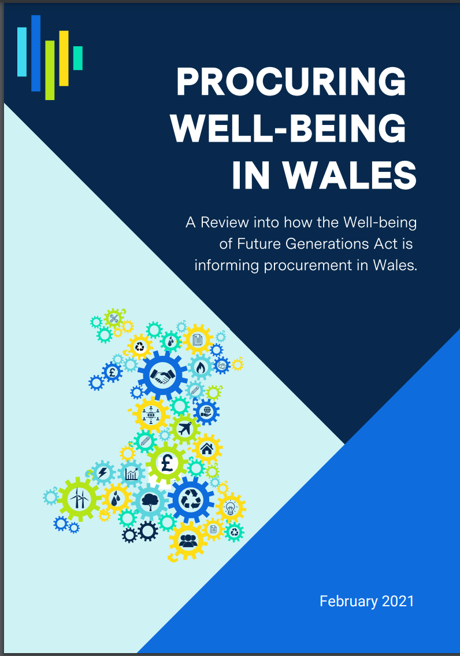
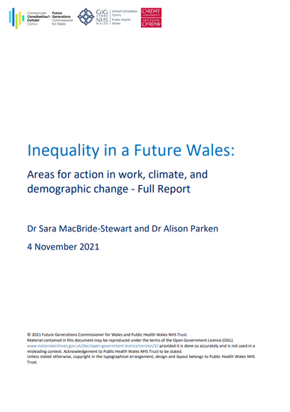
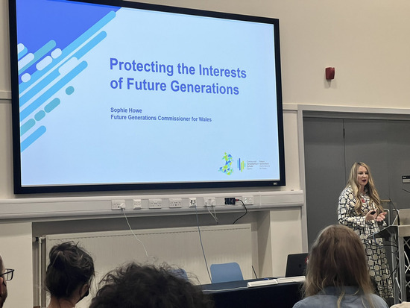
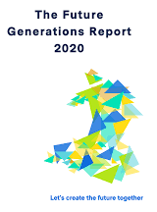
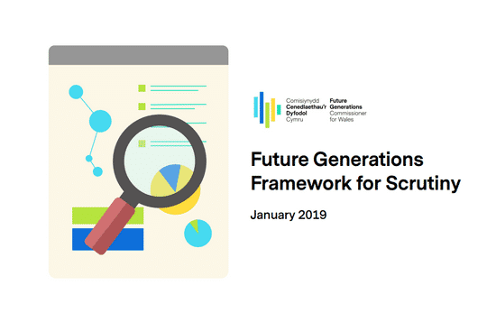
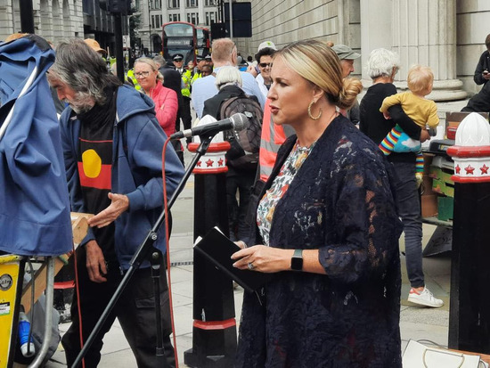
Future Generations Commissioner's powers/duties
Advice and assistance on Act
Encourage best practice and promote awareness
Monitor and assess progress towards well-being objectives
Undertake research
Conduct reviews into application of the Act
Publish a Future Generations Report
Notes:
What we are and what we're not / Our role:
Not an extra layer to appeal to (Planning Inspectorate, Welsh Government, Public Service Ombudsman)
No express statutory case work function or advocacy powers
No express statutory enforcement powers
Only express power to conduct reviews – potentially we could review any decision or any public body
Designing an internal policy setting out a criteria for ‘intervention’ i.e. review

Slide 17
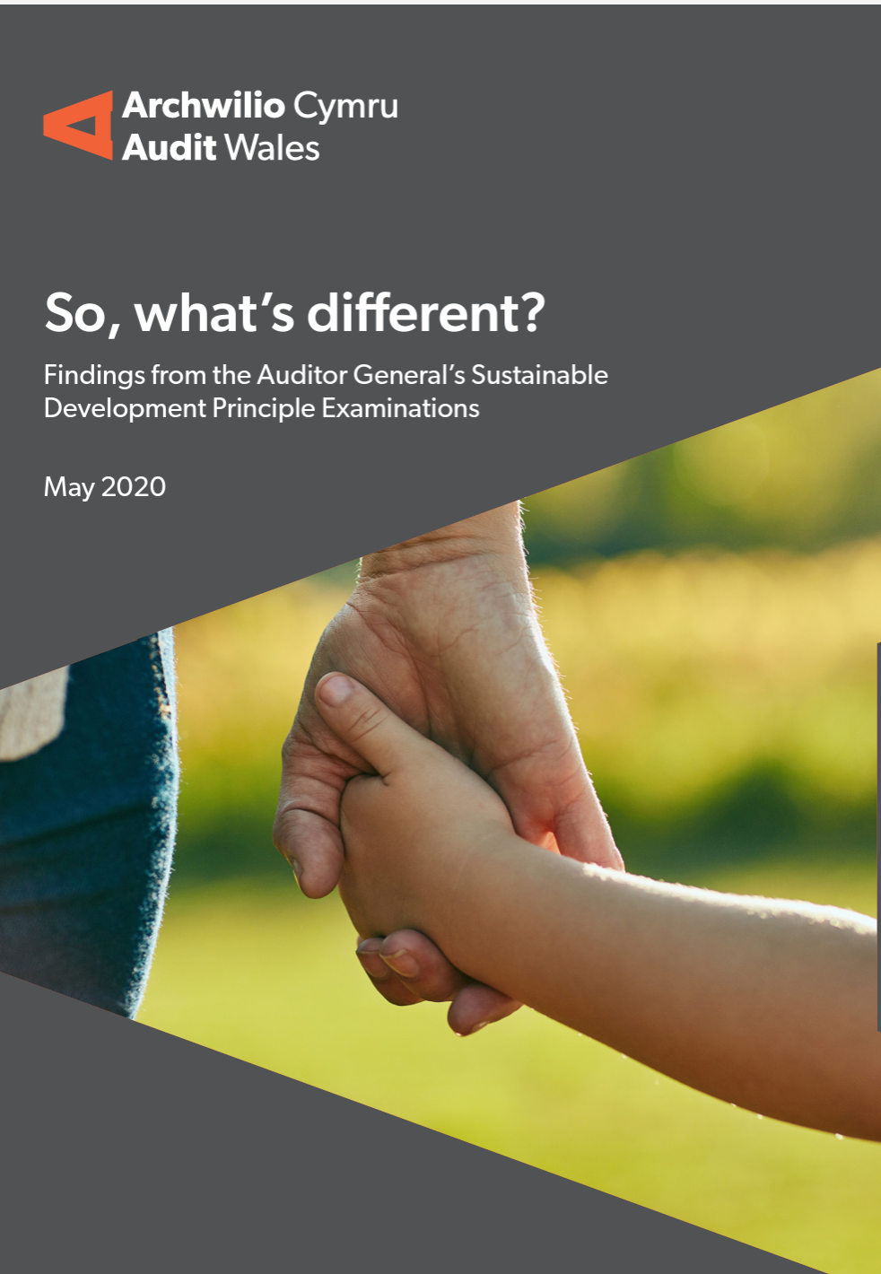
Archwilio Cymru
Audit Wales
cenedlaethaurdyfodol.cymru | futuregenerations.wales | @futuregencymru
Notes:
Audit Wales' role
The Auditor General for Wales may carry out examinations of public bodies for the purposes of assessing the extent to which a body has acted in accordance with the sustainable development principle when (a)setting well-being objectives, and (b)taking steps to meet those objectives.
Worked with them in setting question hierarchies and measures of success.
Must consult the Commissioner and take into account advice and assistance given to the public body, reviews or recommendations from FGCW.
5 year report – same time as FG Report – in line with Welsh Govt elections.
MOU in place with FGCW – work closely together e.g. share intell through PB Leads, observatory member on S20 Review Steering Groups, align messaging in 5 year reports, work closely with GPEx.

Slide 18
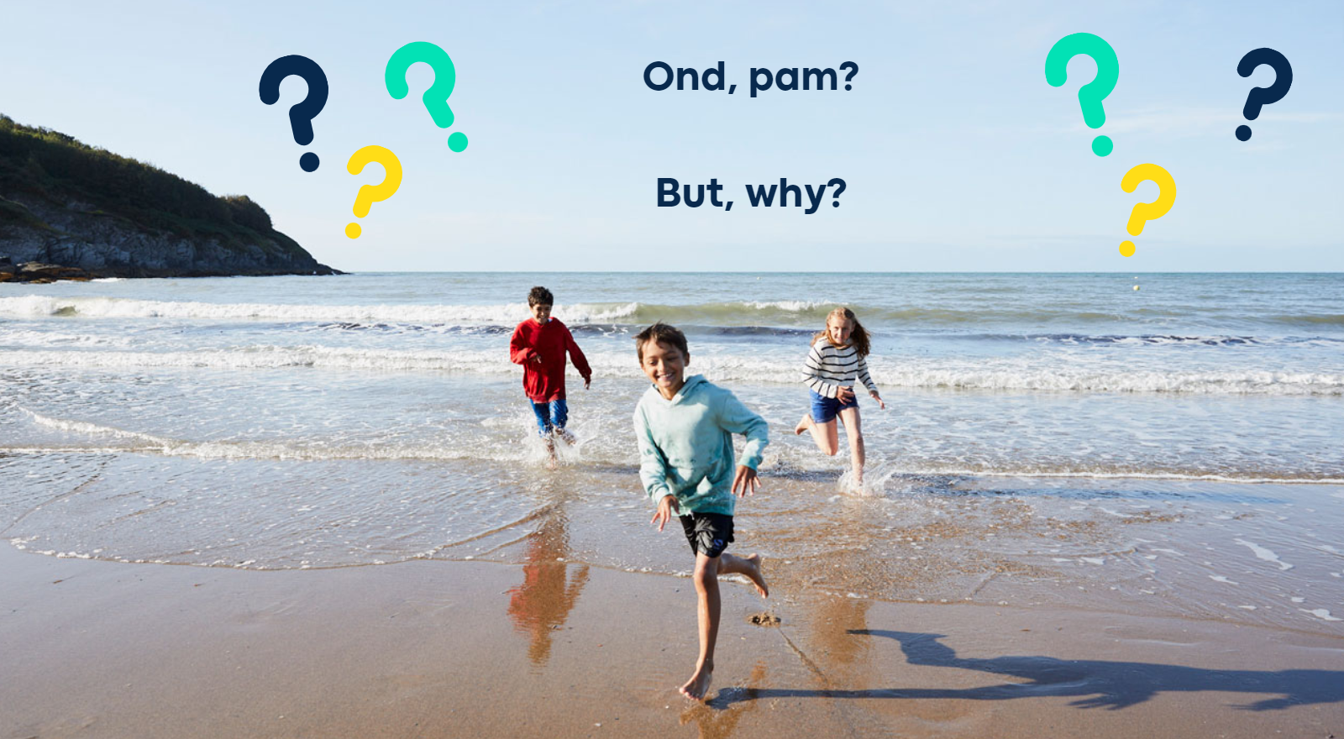
Image from assets.wales.com
Notes:
So I'll pause here at the end of a very technical part of the session to dwell on the question – but why? Why do we need to place sustainable development at the centre of our organisational approaches? Why is it important to think about those yet to be born?

Slide 19
Faint o bobl sydd yn byw yn y Byd heddiw?
How many people live on Earth today?
Faint o bobl sydd wedi byw yng nghynt?
How many people do you think have lived before us?
Ydy'r ateb i cwestiwn 2 fwy neu lai nac ein cenedlaethau'r dyfodol? Is the answer to question 2 more or less than the number of future generations to come?

Slide 20
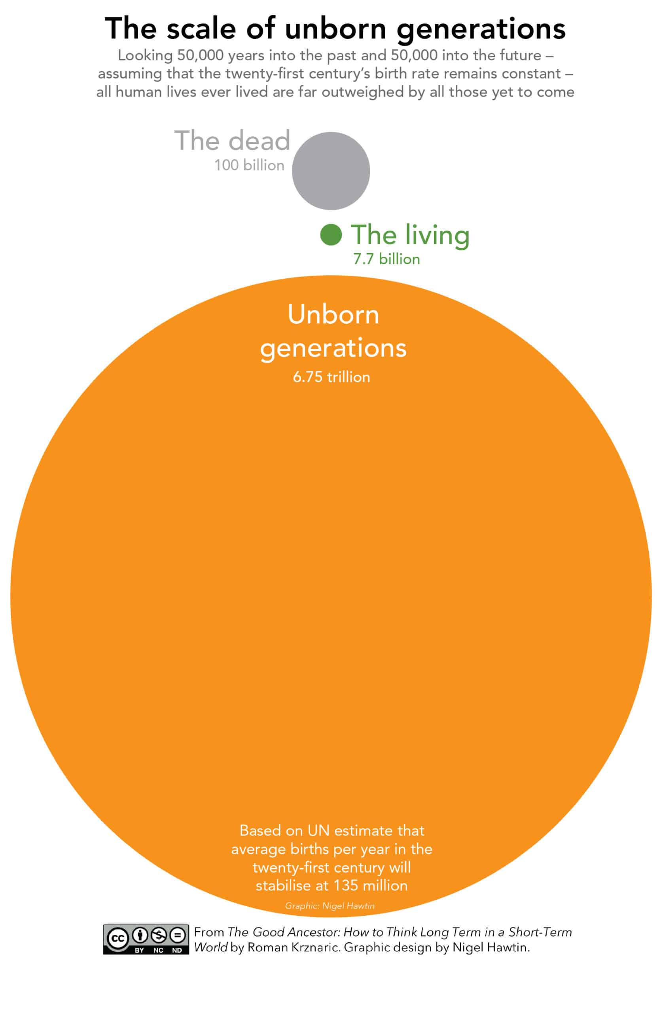
Unborn generations = 6.75 trillion

Slide 21
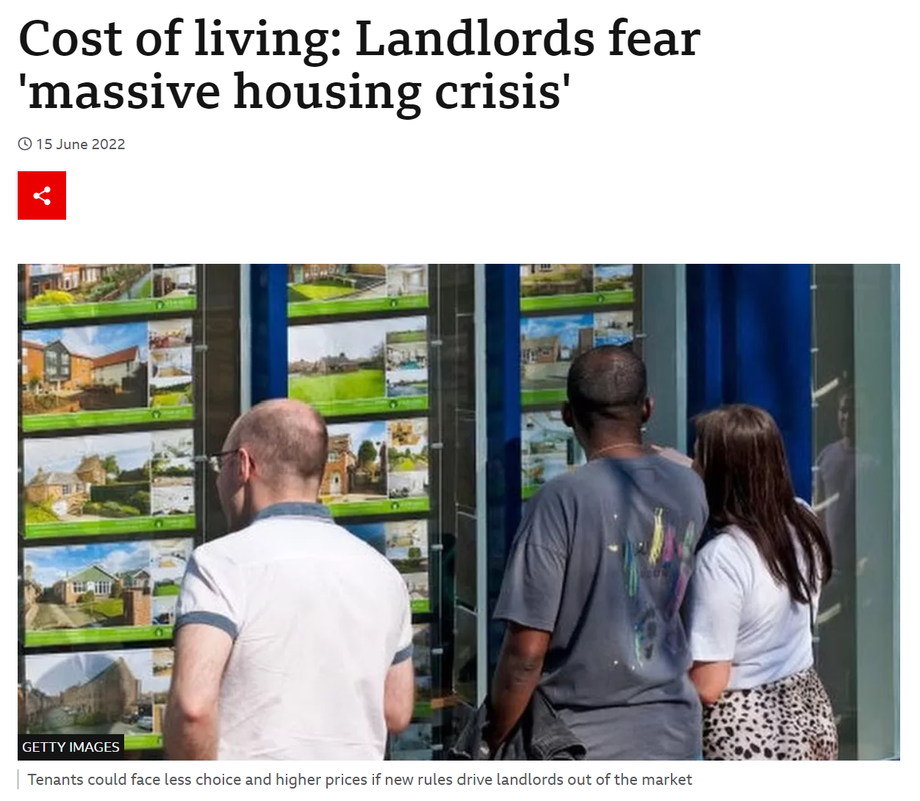
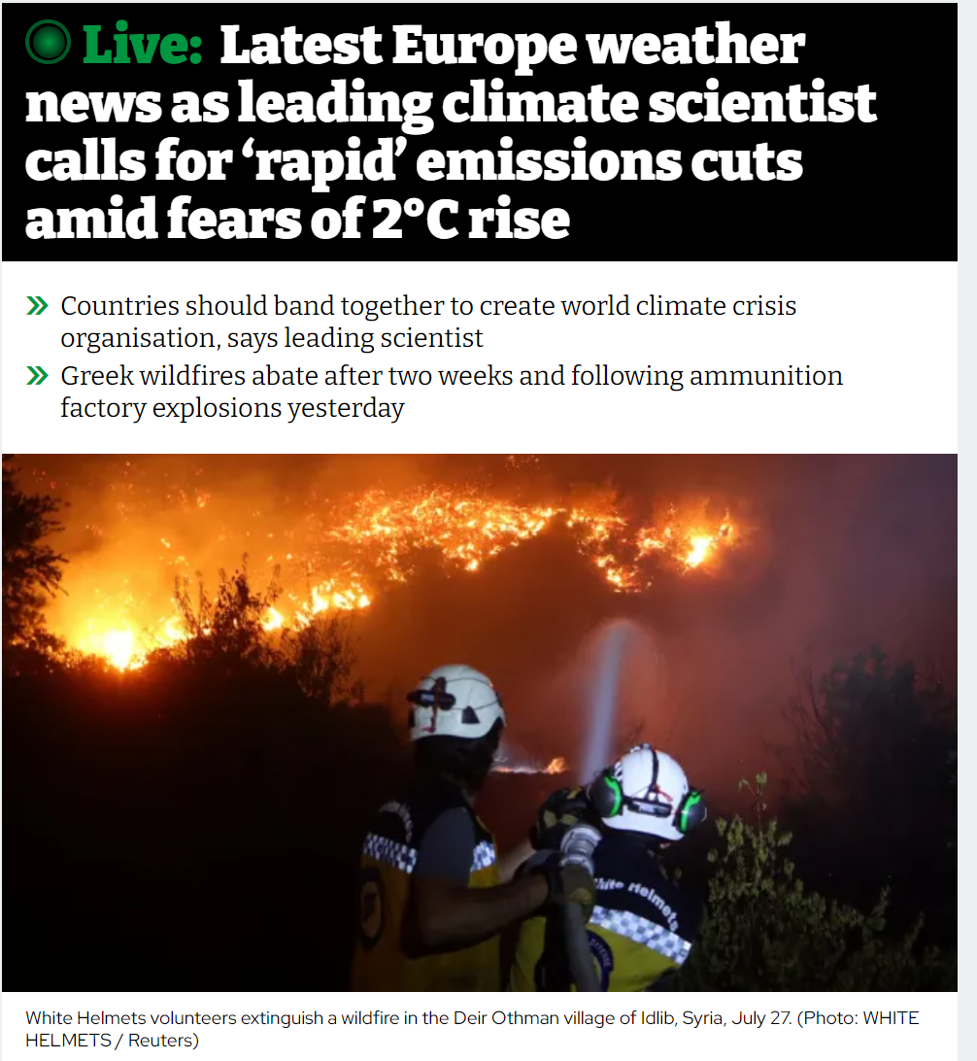
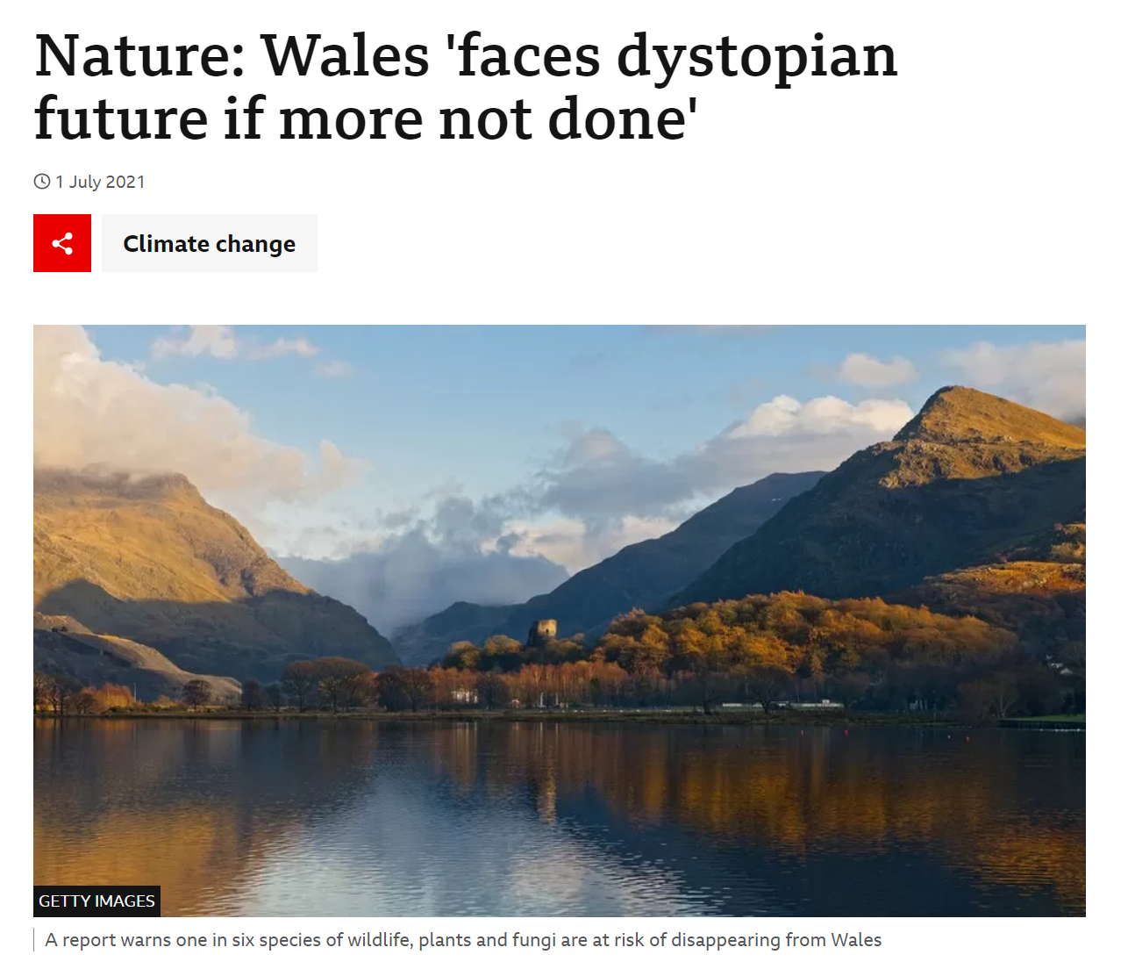
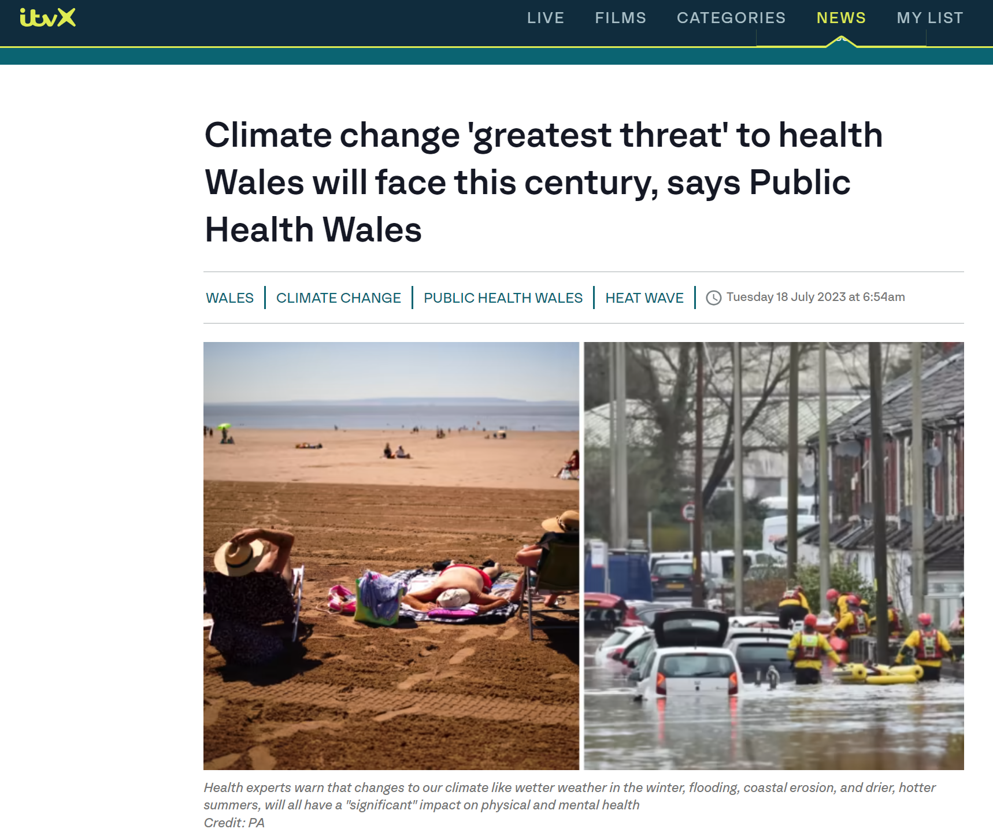
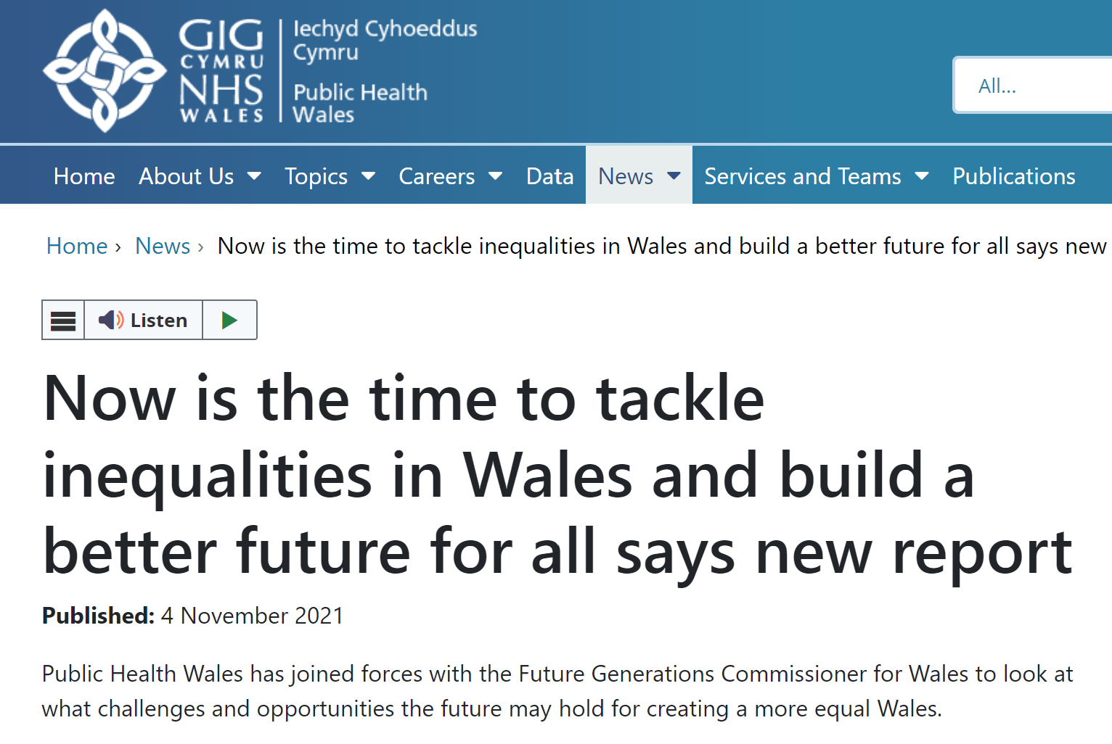
Notes:
Challenges now and to come – climate, wildfires, affordable housing, waste,
Humans too long borrowing from the future, at least in the West. Acting today as if no there is no tomorrow.

Slide 22
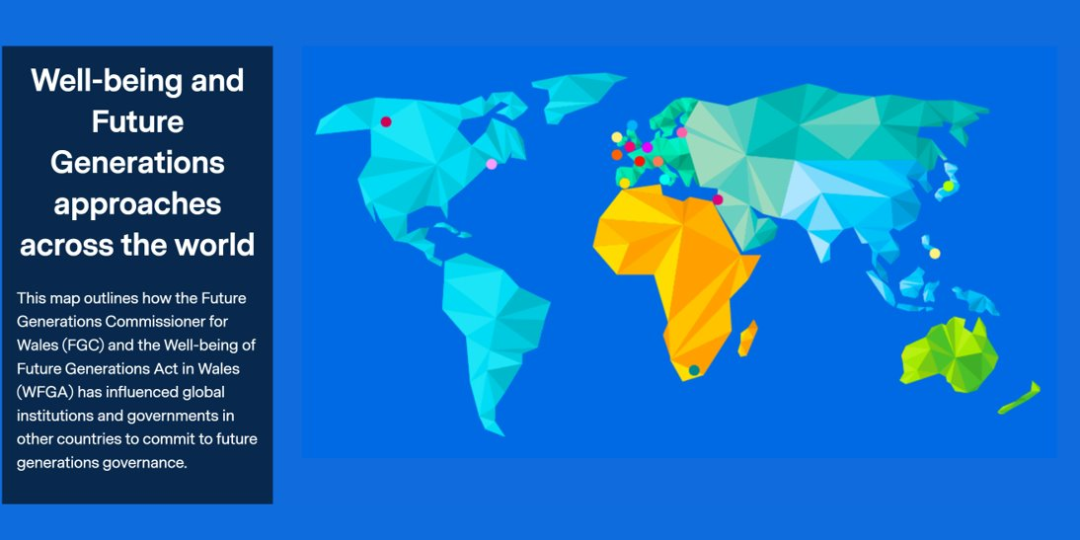
“What Wales is doing today the world will do tomorrow”​​
Nikil Seth, former Director of Sustainable Development United Nations (2015)
Agweddau Llesiant a Chenedlaethau’r Dyfodol ar draws y byd
Mae’r map hwn yn amlinellu sut mae Comisiynydd Cenedlaethau’r Dyfodol Cymru a Deddf Llesiant Cenedlaethau’r Dyfodol yng Nghymru wedi dylanwadu ar sefydliadau byd-eang a llywodraethau mewn gwledydd eraill i ymrwymo i lywodraethu cenedlaethau’r dyfodol.
cenedlaethaurdyfodol.cymru | futuregenerations.wales | @futuregencymru
Notes:
https://www.futuregenerations.wales/global-influence-of-the-act/
Perhaps that's where the Act brings hope – a different way of doing things here in Wales – and world over. When the Act was introduced (and since) it has been admired world-over. Check out our website to see what different countries are doing around SD and well-being of FG.

Slide 23
Notes:
We're already celebrating some of the great things that Change Makers are doing all over Wales. https://www.futuregenerations.wales/impact/impact-of-the-act/

Slide 24
Resources – case studies
Adnoddau - astudiaethau achos
Widening engagement with young people
Ehangu ymgysylltiad â phobl ifanc
Transforming how we move around Cardiff
Newid modd trafnidiaeth Caerdydd
Arts and culture in well-being
Iechyd a diwylliant
Swansea's approach to housing
Dull Abertawe o ymdrin â thai
People shaping their communities
Pobl yn rhoi ffurf ar eu cymunedau i’r dyfodol
Local museums improving well-being
Amgueddfeydd lleol yn gwella llesiant
cenedlaethaurdyfodol.cymru | futuregenerations.wales | @futuregencymru

Slide 25
Resources – case studies
Adnoddau - astudiaethau achos
Re-discovering our valleys
Ailddarganfod ein cymoedd
Maximising well-being through spending
Gwneud y gorau o lesiant trwy wario
Making connections to improve environmental sustainability at Ysbyty Gwynedd
Gwneud cysylltiadau i wella cynaliadwyedd amgylchedd yn Ysbyty Gwynedd
Beyond Recycling: our path towards a circular economy
Mwy nag Ailgylchu: ein llwybr tuag at economi gylchol
Renovating homes, building futures
Adnewyddu cartredi, adeiladu dyfodol
Supporting creative communities
Cefnogi cymunedau creadigol
cenedlaethaurdyfodol.cymru | futuregenerations.wales | @futuregencymru
Notes:
Hopefully that film shows some of the great things that are happening around Wales to move us towards well-being for current and future generations.
If we get this right, our environment improves, our health and social connections, our culture and language thrives and we have a prosperous well-being economy.
OWPS; no wrong door; Equity etc.

Slide 26
Resources – case studies
Adnoddau - astudiaethau achos
Cardiff and Vale enhancing biodiversity
Caerdydd a'r Fro yn gwella bioamrywiaeth
Climate ready Gwent
Gwent yn barod ar gyfer yr hinsawdd
Protecting the well-being of firefighters
Amddifyn llesiant diffoddwyr tân
cenedlaethaurdyfodol.cymru | futuregenerations.wales | @futuregencymru

Slide 27
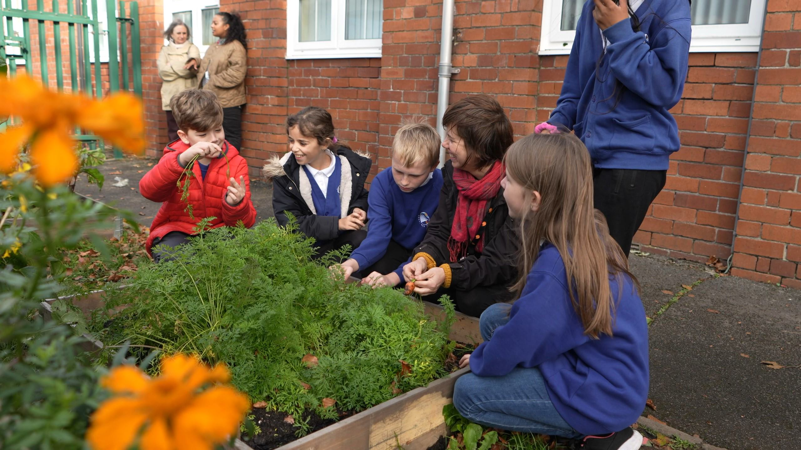
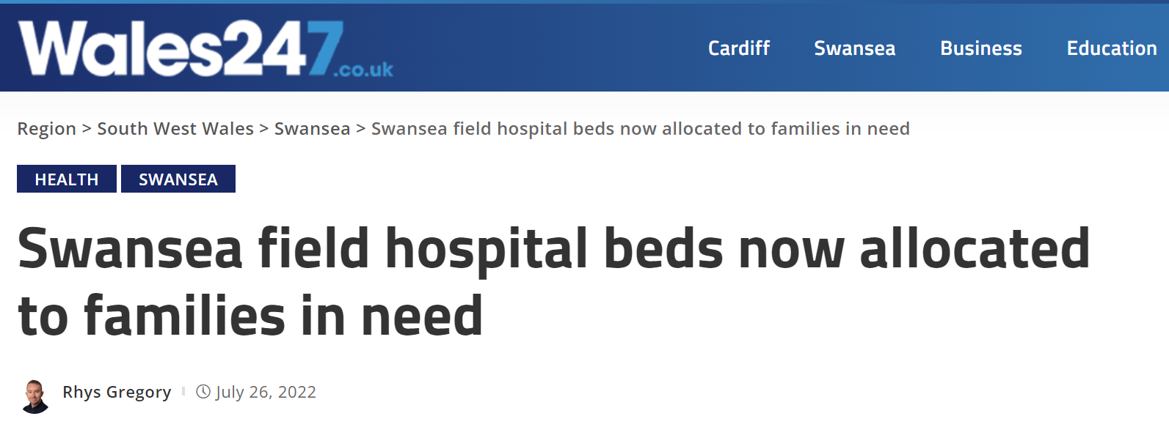
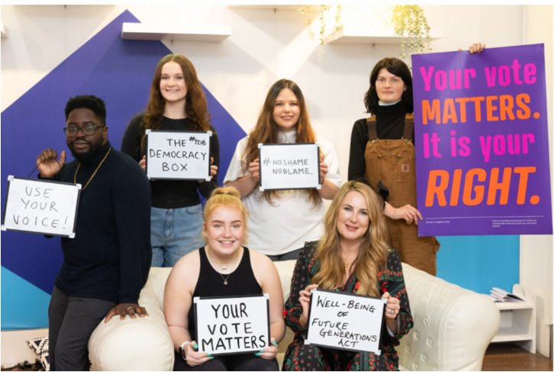
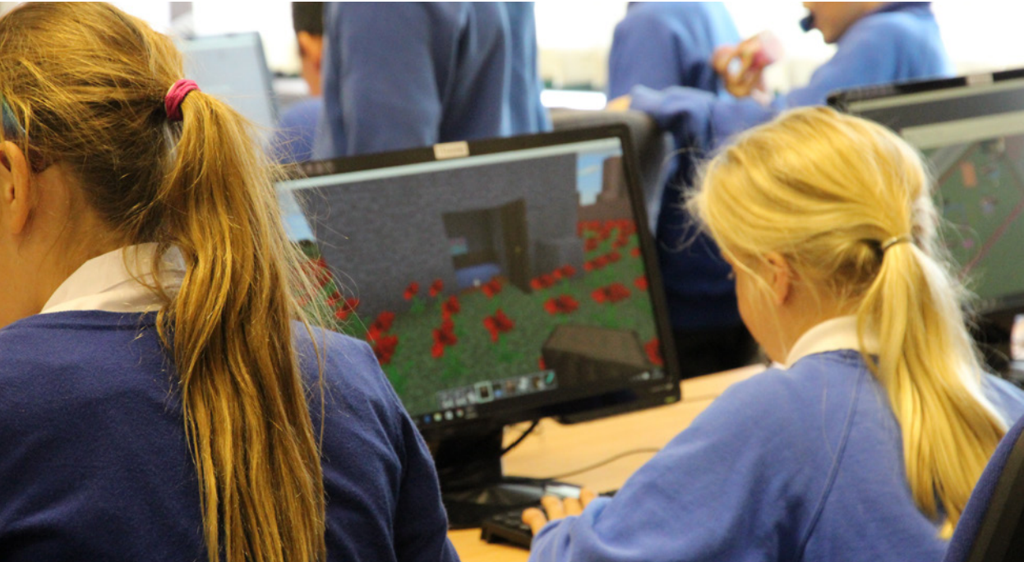
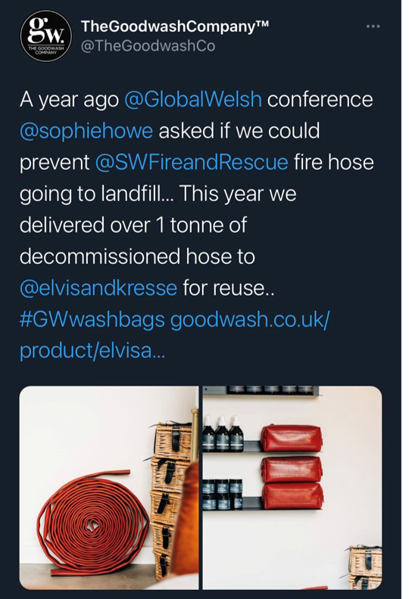
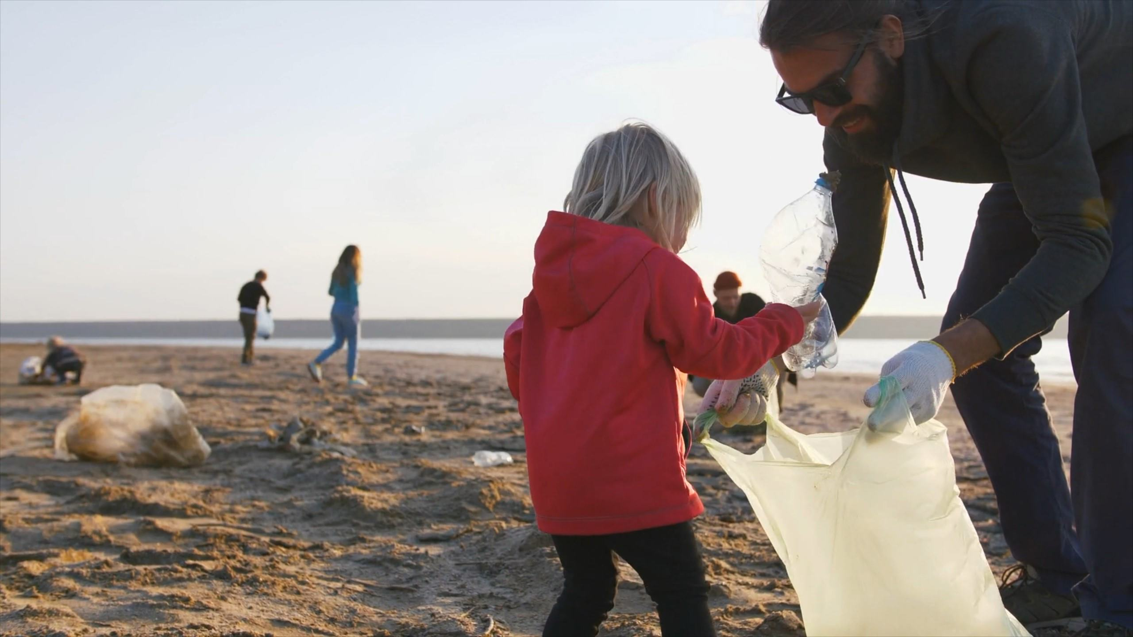
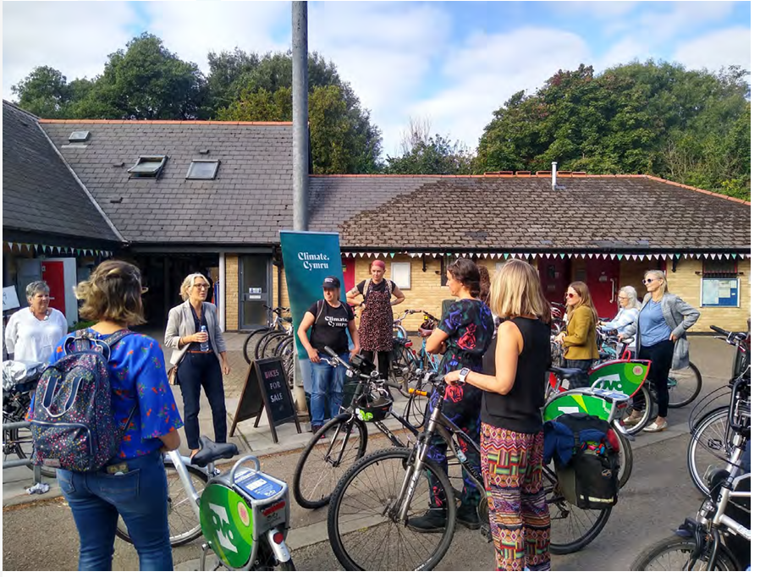
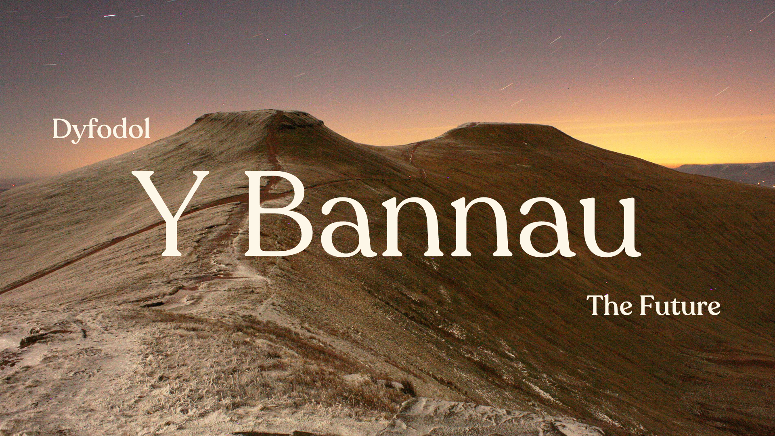
Mae'r stori yn newid...
Stories of change...
Notes:
Abertawe Bro Morgannwg on bed poverty
BB National Park Authority involved people in new innovative ways – Shaping My Brecon Beacons – through Minecraft, adopting a 20-minute neighbourhood local development plan and have published a long-term strategy.
Carmarthenshire County Council has mobilised pupils from 15 schools in support of the United Nation’s Sustainable Development Goals. Pupils run events, raise awareness of climate change, lead action in their communities and share learning with decision makers, which has led to the creation of the Carmarthenshire Climate Action Manifesto.
Ceredigion County Council have trained staff in ‘horizon scanning’, incorporated futures thinking questions into their survey, and developed ‘Gorwel’ with 2 neighbouring Public Services Boards to help bridge medium-longer-term data gaps.

Slide 28
Notes:
Hopefully I've articulated that the Act is not just about publishing corporate documents, but it is a way of thinking and being. It is the oil, not the machine.

Slide 31
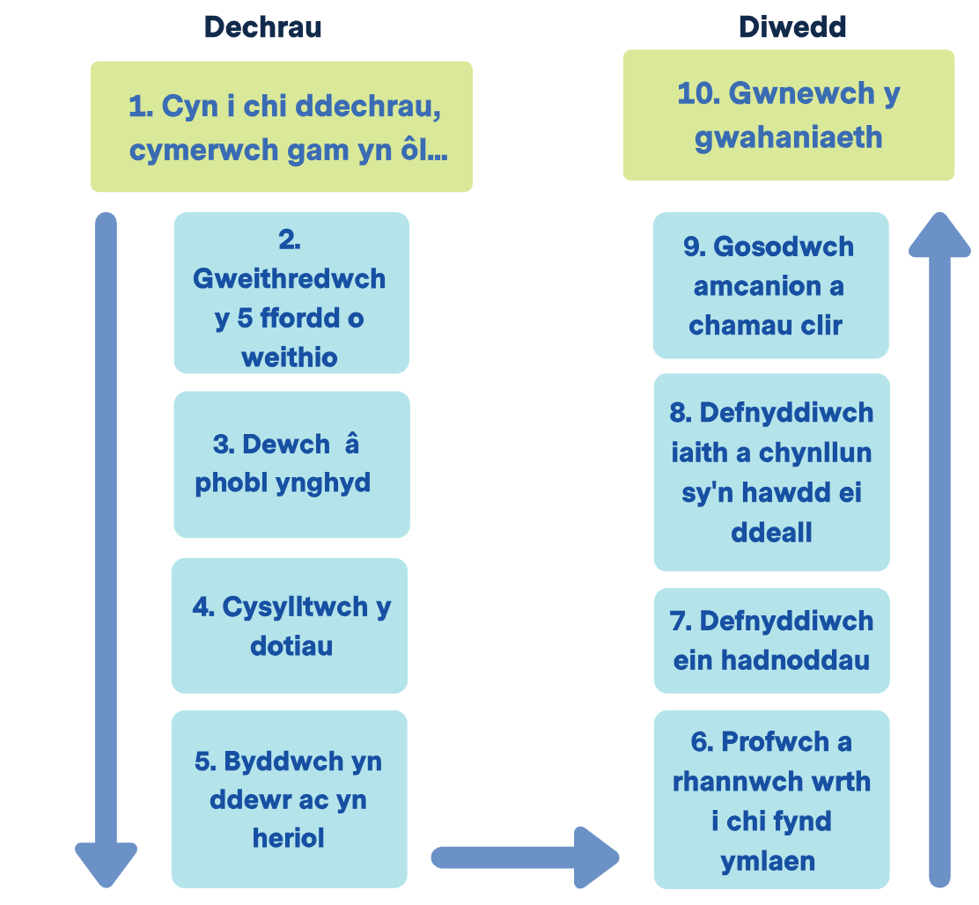
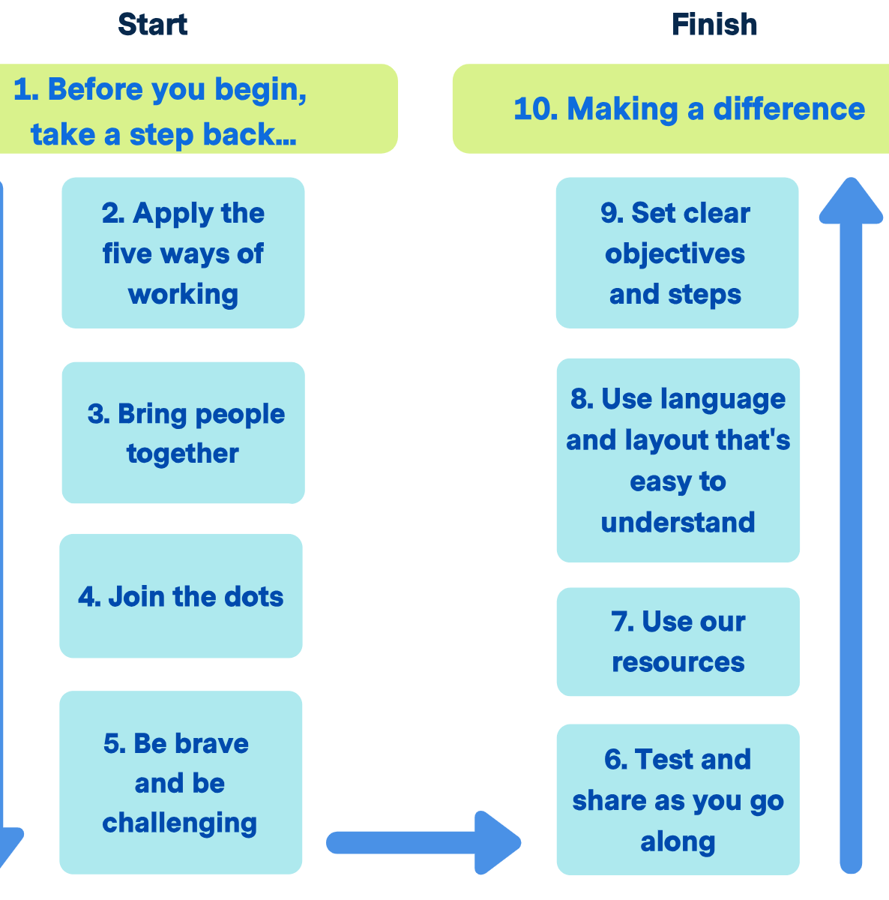
Pennod 4 Adroddiad Cenedlaethau'r Dyfodol - Chapter 4 Future Generations Report 2020:
Notes:
Chapter 4 Future Generations Report 2020: https://futuregenerations2020.wales/

Slide 32
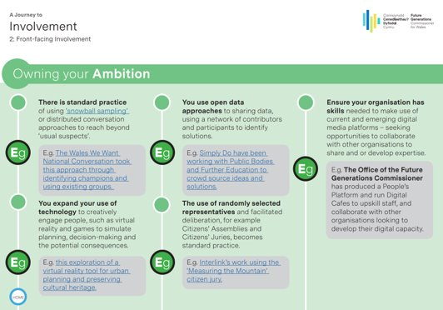
Journeys towards each well-being goal and Involvement:
https://www.futuregenerations.wales/a-healthier-wales/
https://www.futuregenerations.wales/journey-checker-involvement/
Notes:
AOTP Journeys

Slide 36
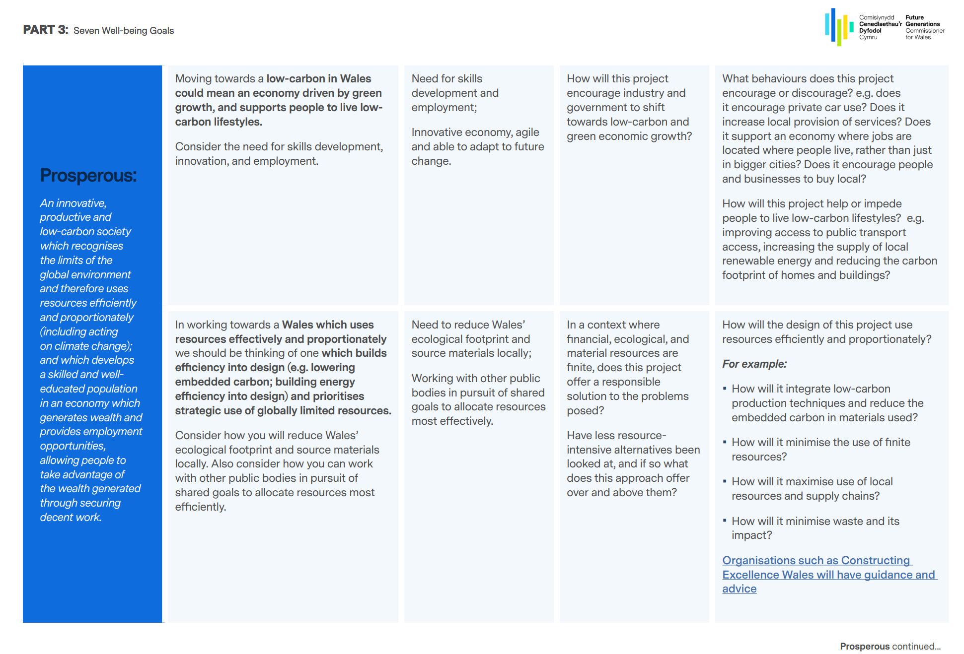
Future Generations Framework for Projects and Service Design
https://www.futuregenerations.wales/resources_posts/future-generations-framework/
https://www.futuregenerations.wales/resources_posts/future-generations-framework-for-service-design/
Notes:
Today we're doing to focus on trialling the Future Generations Framework for projects.
Also one for service design. Also one for scrutiny.

Slide 37
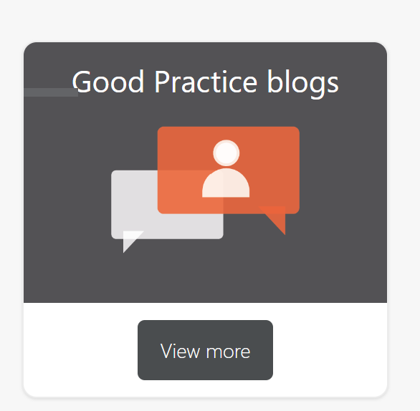
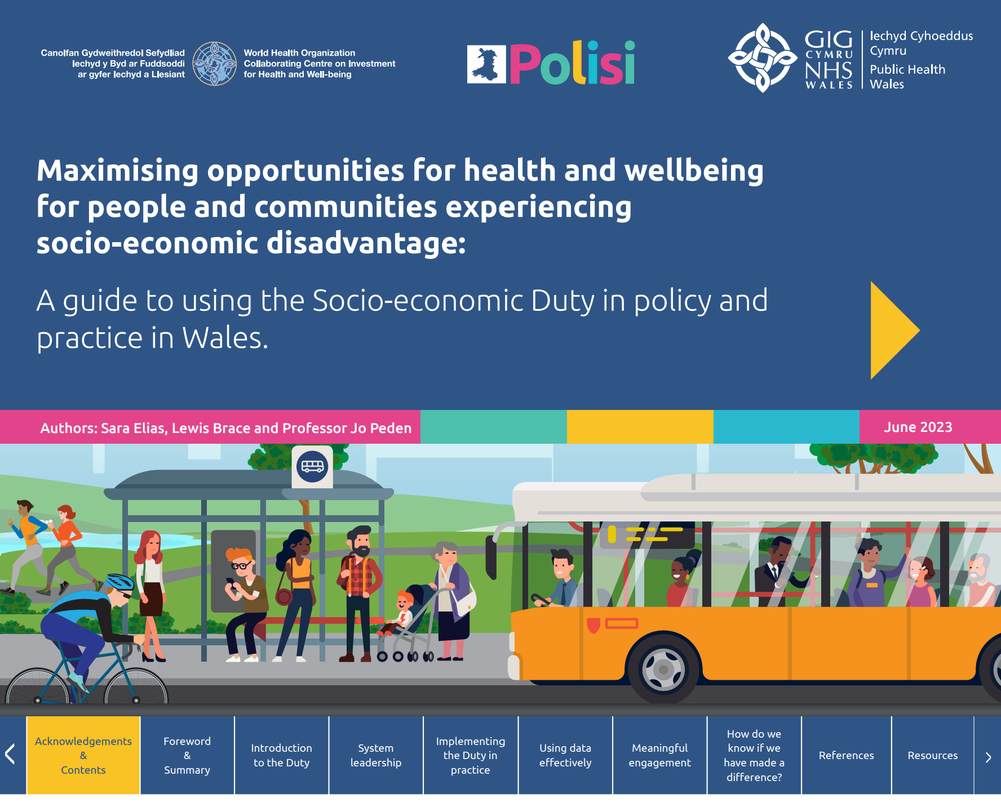
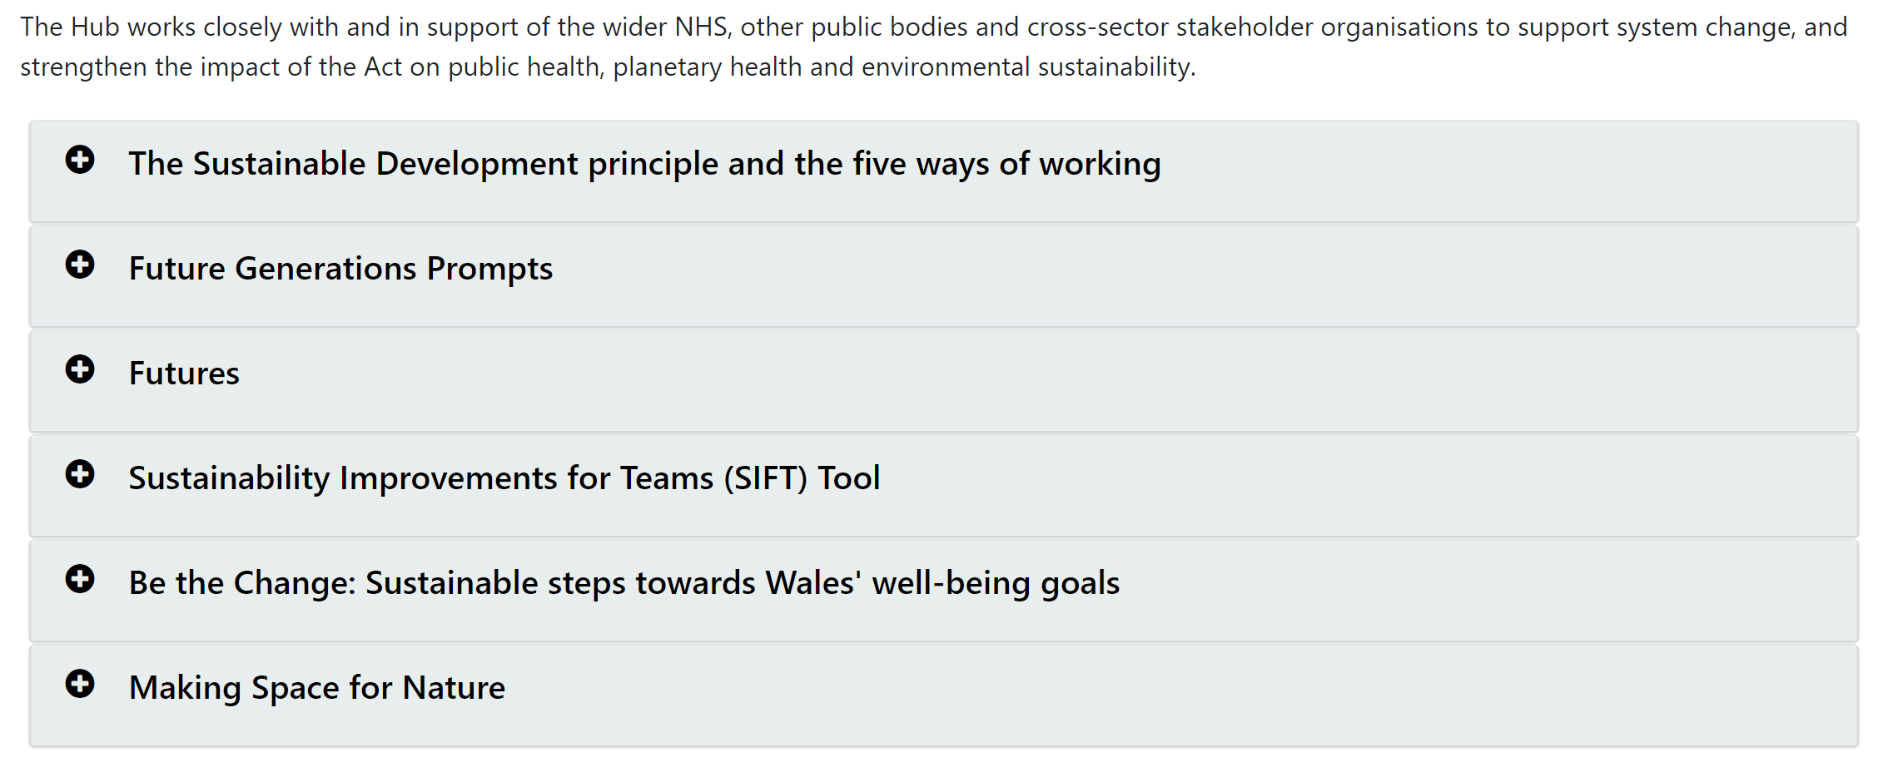
Llawr o adnoddau arall / Many other resources:
http://sdccplus.org.uk/
https://www.audit.wales/our-work/good-practice
Public Health Wales Socio-economic Duty guidance & animation
Public Health Network Cymru webinar
Sustainable Futures Division
Knowledge Exchange Sessions
North Wales insight partnership
https://phw.nhs.wales/topics/health-and-sustainability/
Notes:
Talk about SON and run through other resources and SDCC+.

Slide 39
Amser i fyfyrio a thrafod
Some time to reflect and discuss

Slide 40
Y sesiwn yma / This session:
Trwy'r sesiwn hon byddwch yn:
Cynyddu eich gwybodaeth am Ddeddf Llesiant Cenedlaethau’r Dyfodol a’r hyn y mae’n ei olygu i gyrff cyhoeddus.
Dyfnhau eich dealltwriaeth o sut mae egwyddor datblygu cynaliadwy yn siapio ac yn dylanwadu ar sut mae cyrff cyhoeddus yn gweithio.
Datblygu sgiliau gweithredu yn unol â'r egwyddor datblygu cynaliadwy (yn seiliedig ar y pum ffordd o weithio).
Defnyddio’r adnoddau ac offer a fwriedir i'ch helpu i dynnu'r dysgu oddi arno a'i gymhwyso i'ch gwaith eich hun.
Through this session you will:
Increase your knowledge on the Well-being of Future Generations Act and what it means for public bodies.
Deepen your understanding of how the sustainable development principle shapes and influences how public bodies work.
Develop skills in acting in accordance with the sustainable development principle (centred around the five ways of working).
Use resources and tools intended to help you take learning away and apply it to your own work.
Ar ddiwedd y sesiwn byddwch yn gallu:
Siarad am Ddeddf Llesiant Cenedlaethau’r Dyfodol a pham ei bod yn ddarn mor bwysig o ddeddfwriaeth.
Eglurwch rôl eich sefydliad o dan y ddeddfwriaeth.
Rhoi enghraifft o pryd a sut i ddefnyddio'r ffyrdd o weithio.
At the end of the session you’ll be able to:
Talk about the Well-being of Future Generations Act and why it is such an important piece of legislation.
Explain your organisations’ role under the legislation.
Give an example of when and how to use the ways of working.
cenedlaethaurdyfodol.cymru | futuregenerations.wales | @futuregencymru
Notes:
Revisiting learning outcomes of the session – do they feel this has been achieved? Would love to hear their feedback.

Slide 41
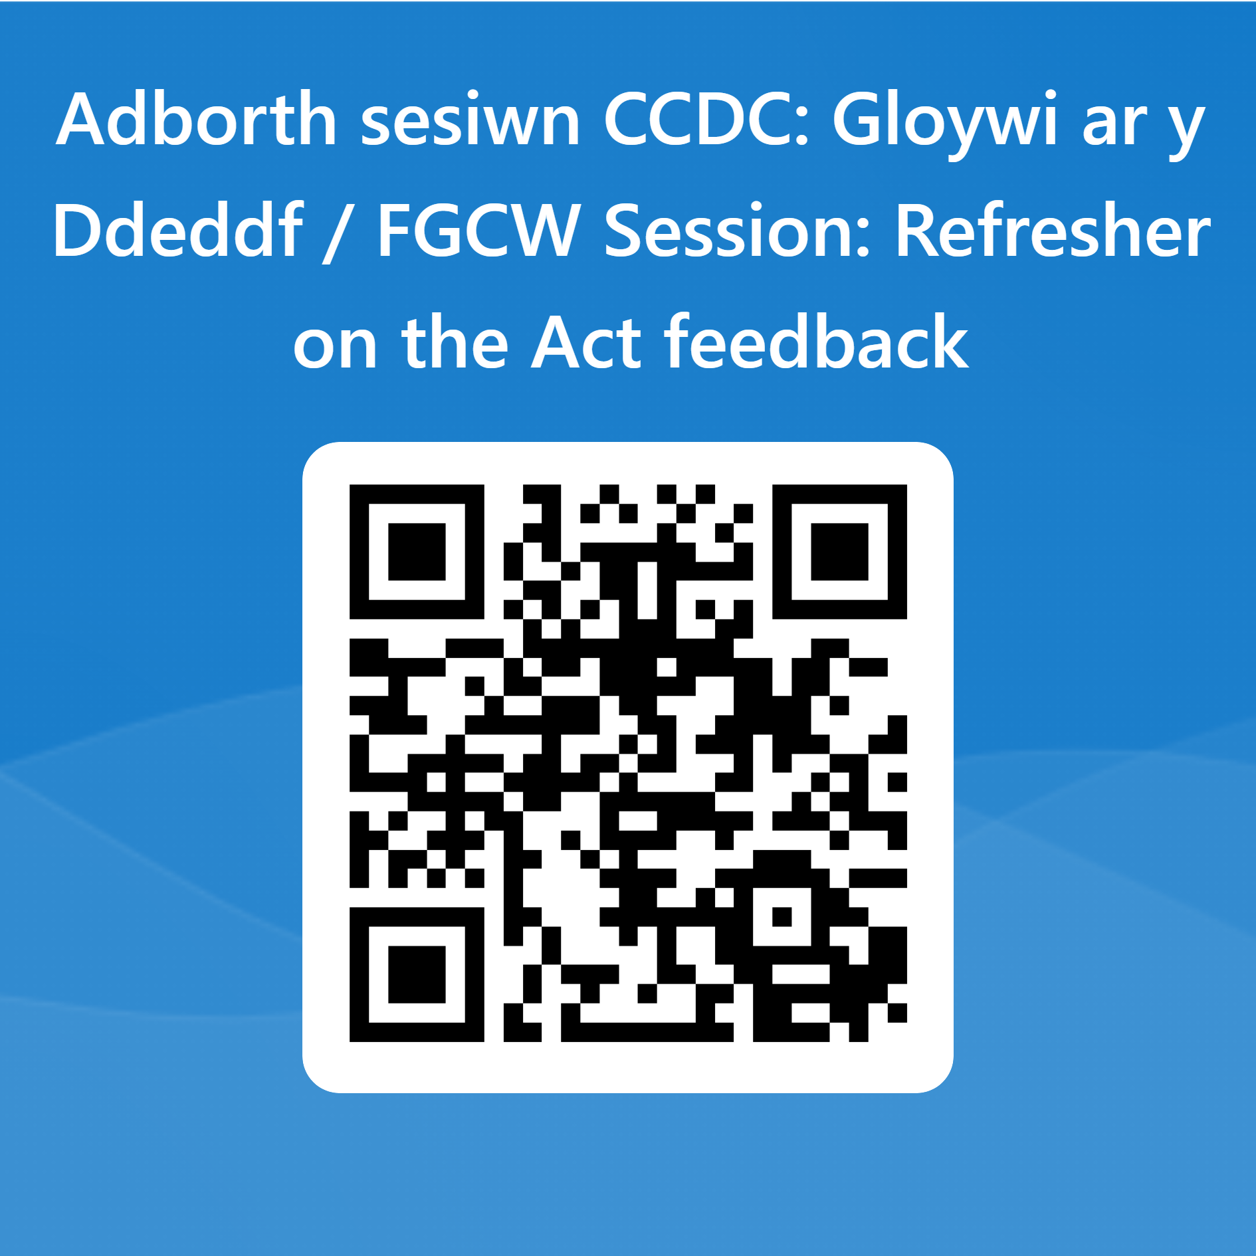
Feedback form
Ffurflen adborth
https://forms.office.com/e/Cx4MpUCwn4
contactus@futuregenerations.wales
cenedlaethaurdyfodol.cymru | futuregenerations.wales | @futuregencymru

Slide 42
Diolch yn fawr iawn
Notes:
- Each public body and PSB covered has a dedicated point of contact within our team.
Point 1: Self-explanatory.
- We offer a range of learning and development opportunities to public bodies and PSBs in Wales. These can be found online here.
Point 2: Highlight a few examples of our upcoming courses.

